Slide 1
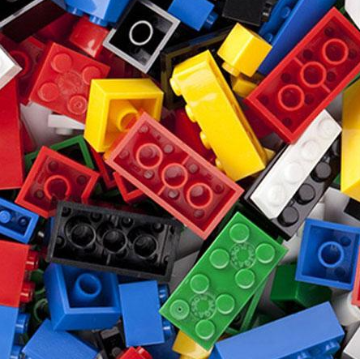
Referencing with Lego

Slide 2
Understanding Referencing
The workshop objective is to:
Improve understanding of Referencing
Improve knowledge of useful tools
(i.e. Cite them Right & the Visual
Referencing Guide)
Gain familiarity of above
Practice referencing
Have fun!

Slide 3
Task 1
You have 5 minutes to
create an object using at least 10 Lego bricks,
from at least 3 different boxes

Slide 4
Why we reference
Creating our own work, using Ideas and theories from other writers is an important part of academic writing.
However, we need to ensure that we acknowledge these authors in our work.
Failure to do so, is plagiarism.
If we do not know the author of an idea or a quote, then we cannot use it.
If you do not know which box the Lego in your creation has come from, then you cannot use it.
Without all of the pieces, your creation may change shape or fall apart!
Without proper referencing you may fail your assignment or be accused of cheating or plagiarism which is a serious matter.

Slide 5
How we reference
Use:
&
Visual Referencing Guide
Access from Library Libguides page

Slide 6
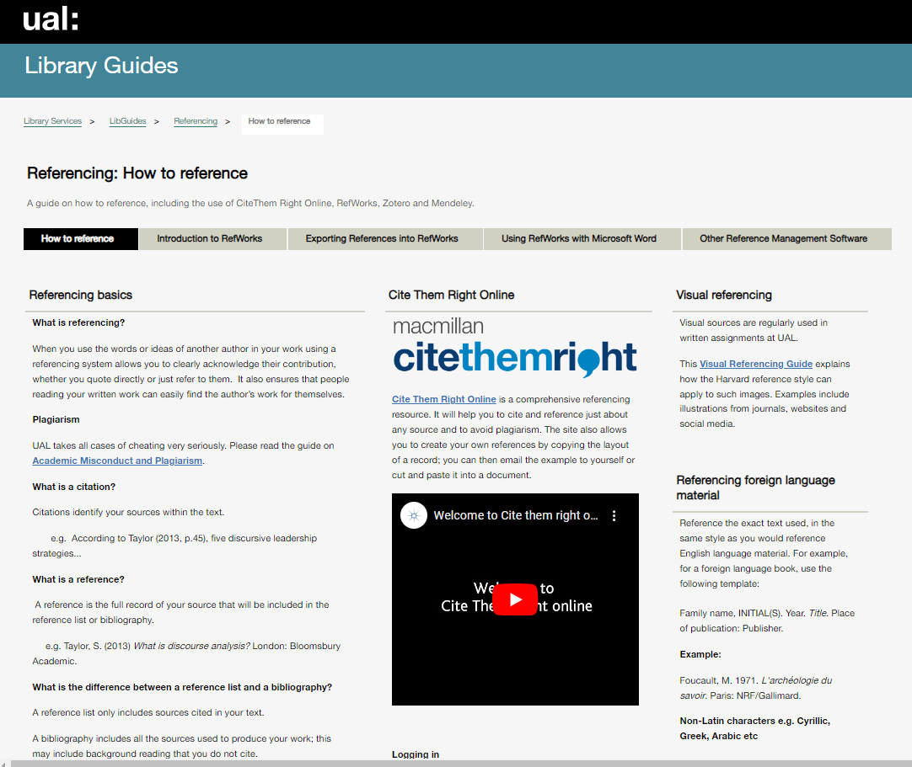
Access via the Library Guides page
https://arts.ac.libguides.com/referencing

Slide 7
The Visual Referencing Guide written by Liz Higgs and Lucy Panesar
Visual sources are regularly used in written assignments at UAL. This Visual Referencing guide explains how the Harvard reference style can apply to such images. Examples include illustrations from journals, websites and social media.
https://academicsupportonline.arts.ac.uk/system/files/2019-12/visual-referencing-guide.pdf

Slide 8
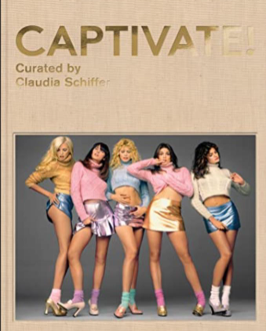
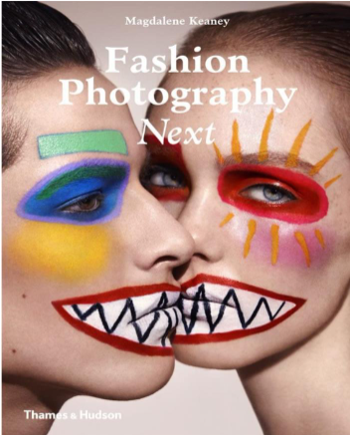
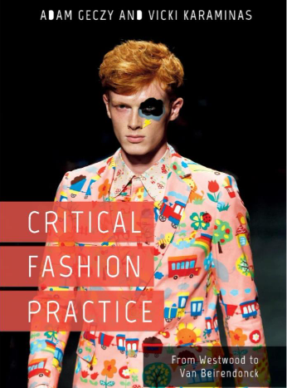
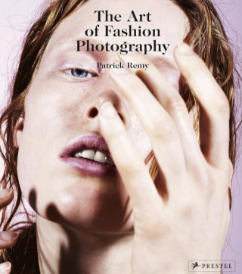
Task 2
Match the book descriptions to the book covers

Slide 9
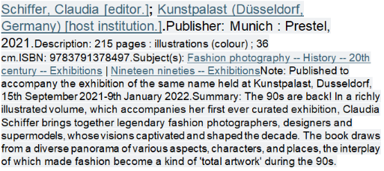
by:Keaney, Magdalene [author.]; Weber, Eleanor [author.].Publisher: London : Thames and Hudson, 2014.
Geczy, A. , & Karaminas, V. (2018). Critical Fashion Practice: From Westwood to van Beirendonck. London: Bloomsbury Academic. Accessed: November 4, 2023, http://dx.doi.org/10.5040/9781474265560
Remy, Patrick [author.] Language: English Summary language: FrenchPublisher: Munich : Prestel, [2014]Copyright date: ©2014

Slide 10
Task 3
Create a Citation for one of the books using Cite them Right to help you if you need to
Don’t forget we use Harvard Referencing at UAL

Slide 11
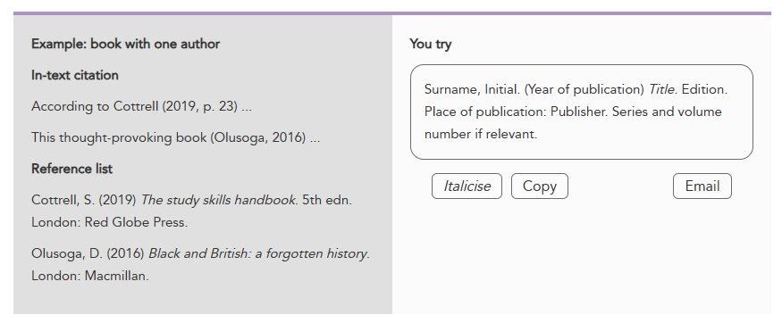
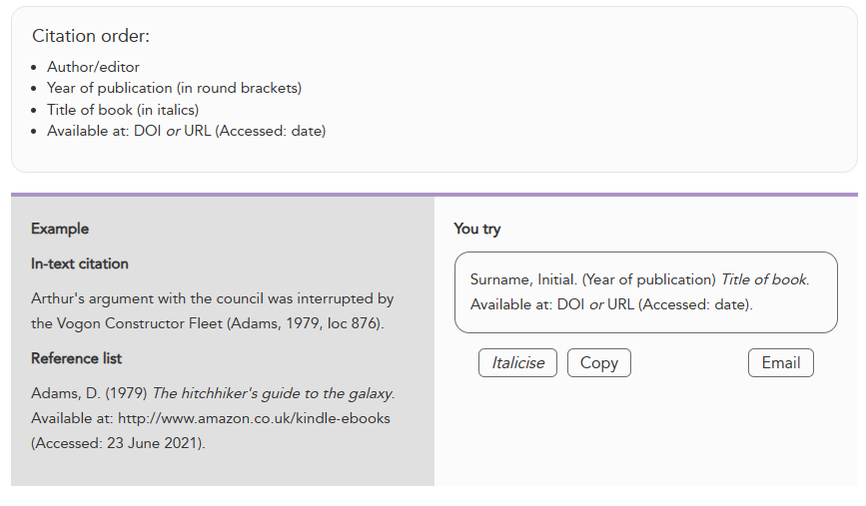

Slide 12
References
Geczy, A. and Karaminas, V. (2018), Critical Fashion Practice: From Westwood to van Beirendonck. Available at: http://dx.doi.org/10.5040/9781474265560 (Accessed: 4 November 2023)
Keaney, M and Weber, E. (2014) Fashion Photography Next. London: Thames and Hudson.
Remy, P. (2014) The Art of Fashion Photography. Munich: Prestel
Schiffer, C. (2021) Captivate! Munich: Prestel

Slide 13
Thank you!
We hope that you enjoyed the session!
If you have any further questions, you can usually find me in the library
Tuesday to Thursday, or,
e-mail: l.french@arts.ac.uk
Please complete the feedback form before you leave at the end of the session.
Your feedback is important to us!
https://forms.office.com/e/6HHaNmQHks

