Slide 1
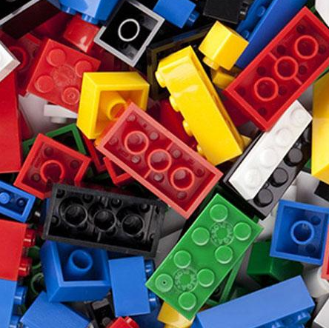
Referencing with Lego

Slide 2
Introductions
A task for you!
There is some Lego on the desks
Please feel free to enjoy a minute
of free building while I Introduce
myself
Have fun!

Slide 3
Research question
How can I incorporate play into my teaching?
How can I make learning about referencing more enjoyable?

Slide 4
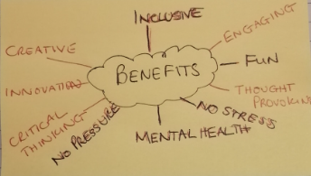
Why LEGO? What are the benefits?
LEGO has a successful track record in Education.
The Benefits of learning through play are accepted in schools and are becoming more accepted in Higher Education.
Allows students to experiment, learn through creativity, develop critical thinking skill and innovation

Slide 5
How is it used in HE?
STEM subjects Own brand
To conceptualize
LEGO Serious Play
Some examples
My Inspiration
Carina Buckley – Southampton
Dan Swanton - Edinburgh
Bianca Fox– Sussex
Andy Legg - Chichester
and of course UAL to name but a few
https://youtu.be/tnT5oNE8aus

Slide 6
The workshop
Conceptualizing referencing with LEGO
Referencing tools
Matching activities, putting new knowledge into practice

Slide 7
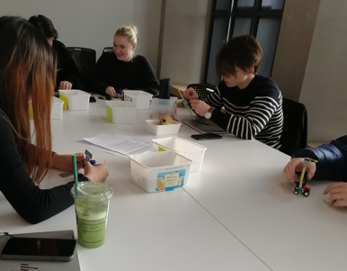
Task 1

Slide 8
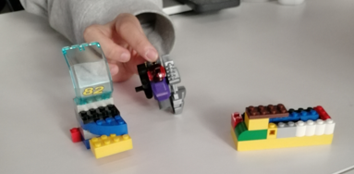
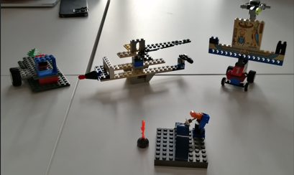
Results for Task 1

Slide 9
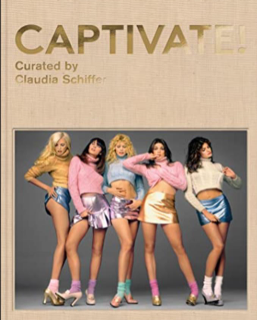
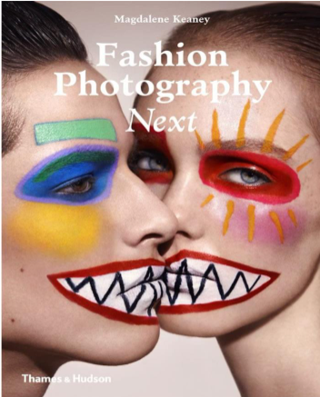
Task 2
Match the book descriptions to the book covers

Slide 10
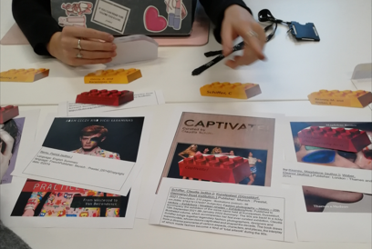
Task 2

Slide 11
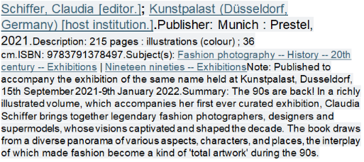
by:Keaney, Magdalene [author.]; Weber, Eleanor [author.].Publisher: London : Thames and Hudson, 2014.
Geczy, A. , & Karaminas, V. (2018). Critical Fashion Practice: From Westwood to van Beirendonck. London: Bloomsbury Academic. Accessed: November 4, 2023, http://dx.doi.org/10.5040/9781474265560
Remy, Patrick [author.] Language: English Summary language: FrenchPublisher: Munich : Prestel, [2014]Copyright date: ©2014

Slide 12
Task 3
Create a Citation for one of the books using Cite them Right to help you if you need to
Don’t forget we use Harvard Referencing at UAL

Slide 13
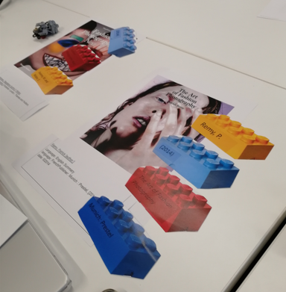
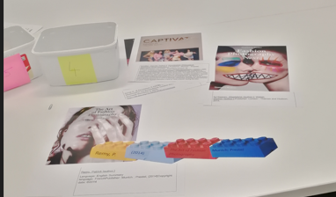
Results for Task 2&3

Slide 15
Feedback
The response rate was not great!
Around a third of the students responded
All feed back was positive and reassuring for the workshop

Slide 16
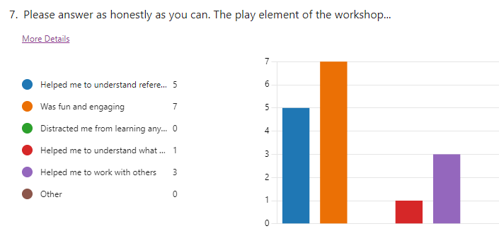
By using MS Forms a lot of the Analysis was already done for me. I did not have to trawl through lots of answers to create data sets etc, or use triangulation to bring responses together from different sources as the Feedback form and observations were my only sources. Had I been able to conduct some interviews, there would have been a lot more analysis to do. Although, it is worth mentioning that I did question the analysis on a couple of questions which I talk more about in my blog.

Slide 17
Reflecting on your experience, at what point in the session did you feel most involved?
What did you learn about referencing that you didn’t know before?

Slide 18
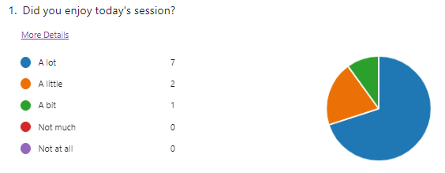
Possibly the most important question of all…

Slide 19
Research question
How can I incorporate play into my teaching?
LEGO
How can I make learning about referencing more enjoyable?

Slide 20
References
Images
Geczy, A. and Karaminas, V. (2018), Critical Fashion Practice: From Westwood to van Beirendonck. Available at: http://dx.doi.org/10.5040/9781474265560 (Accessed: 4 November 2023)
Keaney, M and Weber, E. (2014) Fashion Photography Next. London: Thames and Hudson.
Remy, P. (2014) The Art of Fashion Photography. Munich: Prestel
Schiffer, C. (2021) Captivate! Munich: Prestel
Refrences
Buckley, Carina (2015), ‘Conceptualising Plagiarism: Using Lego to construct students’ understanding of authorship and citation’, Teaching in Higher Education, 20(3), pp. 352-358. DOI: 10.1080/13562517.2015.1016418. Accessed: 28/1/2023
Fox, Bianca (2022) 'Serious play: active learning with Lego bricks', 100 Ideas for Active Learning. Available at: Serious play: active learning with Lego bricks – 100 Ideas for Active Learning (sussex.ac.uk) Accessed 12/12/23
Legg, Andy (2017) ‘LEGO video by Chichester lecturer goes viral via Facebook’, Serious Play.com. Available at: https://seriousplaypro.com/2017/04/12/lego-video-by-chichester-lecturer-goes-viral-via-facebook/ (Accessed12/12/23)
Swanton, Dan (2011) ‘learning-with-lego’, Teaching Matters.16 November. Available at: https://www.teaching-matters-blog.ed.ac.uk/learning-with-lego/Accessed 28/1/2023

Slide 21
Thank you!
Swanton, Dan (2011)
I hope that you enjoyed the Presentation!
If you have any further questions, you can usually find me in the library at LCF
Tuesday to Thursday, or,
e-mail: l.french@arts.ac.uk
If you would like to explore my blog
https://lorifpgcert.myblog.arts.ac.uk/
Swanton, Dan (2011)

